Slide 1
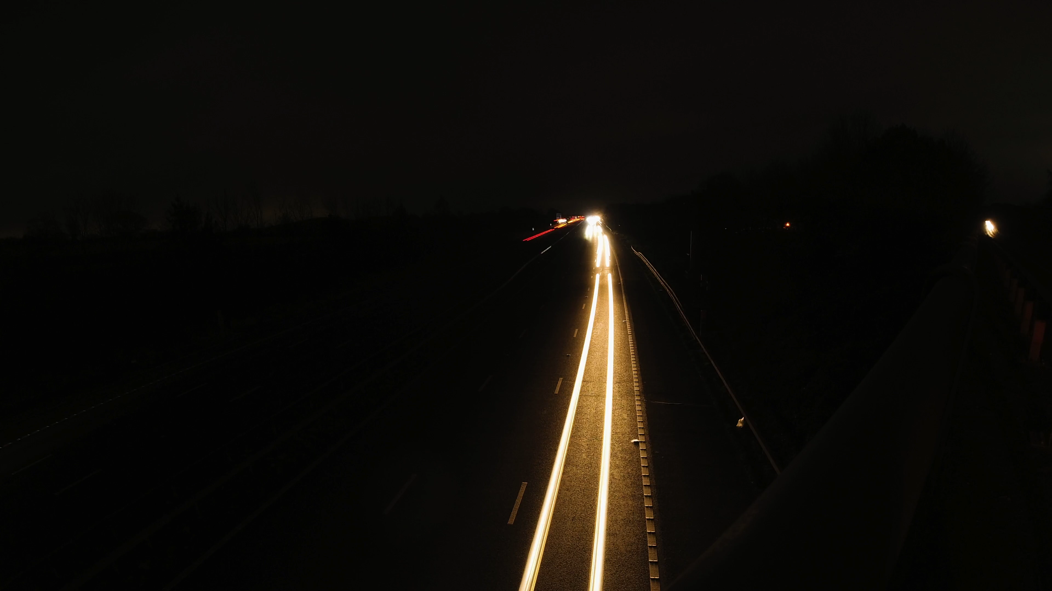
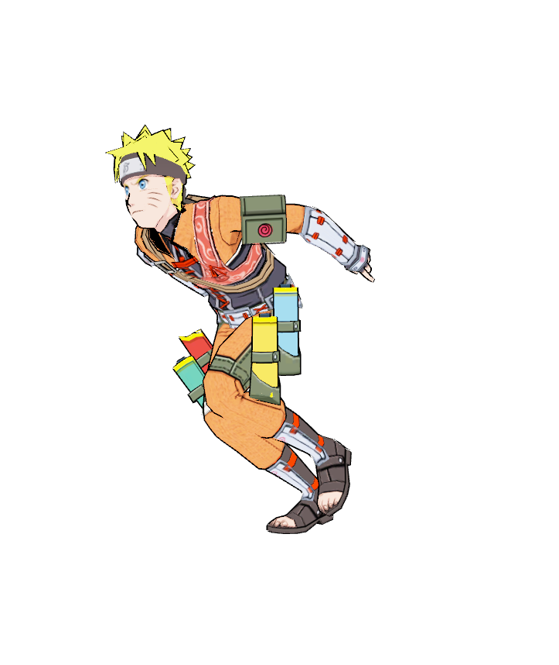
….Born under the crimson sun of Planet Vegeta, Goku’s destiny was etched in stardust.
….His Saiyan bloodline pulsed with primal power, and as a child, he arrived on Earth, a celestial refugee.
....His journey began innocently, chasing dragon balls and training with Master Roshi. But beneath that cheerful grin lay a dormant force—the spirit of a warrior awakening.

Slide 2
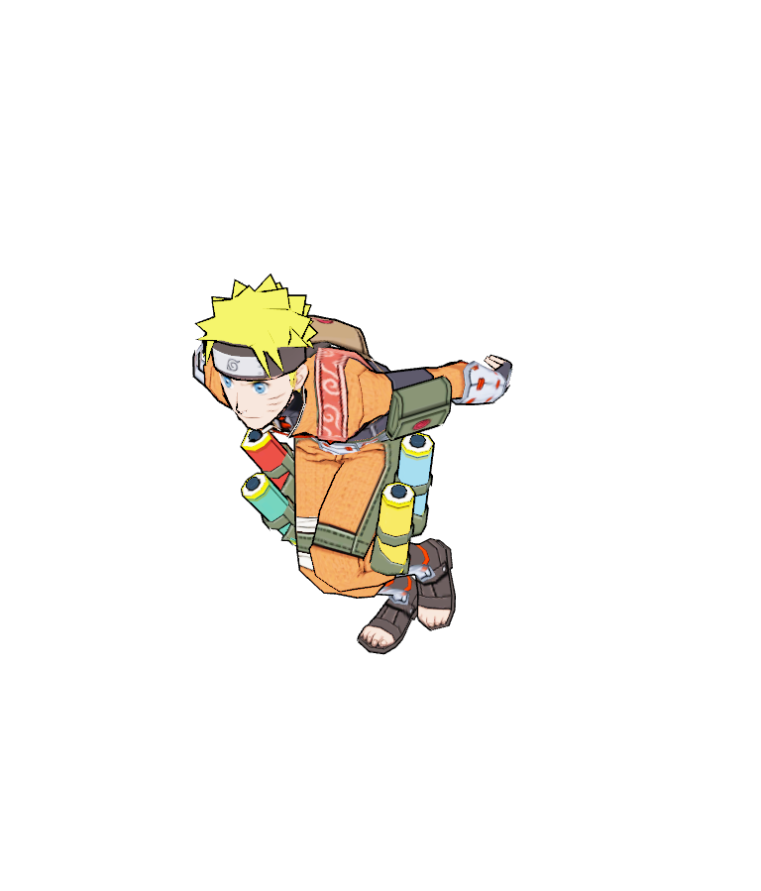
….Goku’s battles are symphonies of energy—each punch a crescendo, each dodge a grace note.
…... His hair ignites with Super Saiyan fire, and galaxies tremble as he clashes with foes: Frieza, Cell, Buu, and beyond.
….His friends—Piccolo, Vegeta, Krillin—compose the harmonies that echo through time.
Together, they defy fate, rewriting the score of the universe.

Slide 3

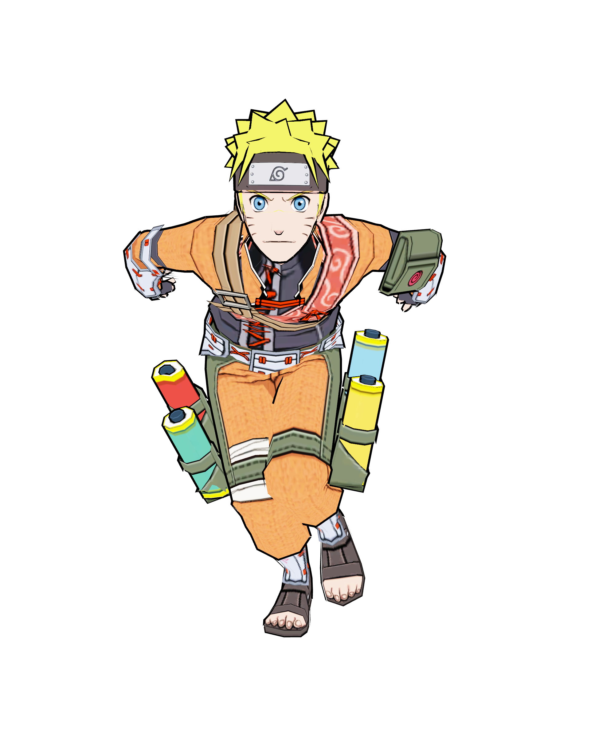
So, raise your hands, fellow warriors, and shout with me: “Kamehameha!” For Goku, the Saiyan who taught us that strength lies not in muscle alone, but in the bonds we forge and the dreams we chase.

